Slide 1
Pumping Station Design with an Analysis of Variability of Demand and Considering Techno-Economic and Environmental Criteria through the AHP Method
Authors
  Christian X. Briceño-León
  Pedro L. Iglesias-Rey
  F. Javier Martínez-Solano
  Enrico Creaco

Slide 2
Index of Contents
Introduction
  Pumping Station Design
  Aproach of the AHP method in Pumping Station Design
Methodology
  Optimization Of The Control System Operation in Pumping Station
  Required Data for Pumping Station Design
  Analysis of variability of Demand
  Development of the proposed methodology
Results
  Pumping Station Design based on the minimization of LCC
  Pumping Station Design considering Technical, Environmental and Economic Criteria
  Discussion
  Conclusions

Slide 3
Introduction
Pumping Station Design
The classic method of a PS design consist of select the pump model, the number of pump and the proper control system configuration to satisfy the operating conditions of the network and to minimize the LCC.
Aproach of the AHP method in Pumping Station Design
Commonly, the design of a PS is based on the minimization of economic aspects. However, this new approach propose to consider other aspects, such as technical and environmental criteria in addition to the economic criteria.

Slide 4
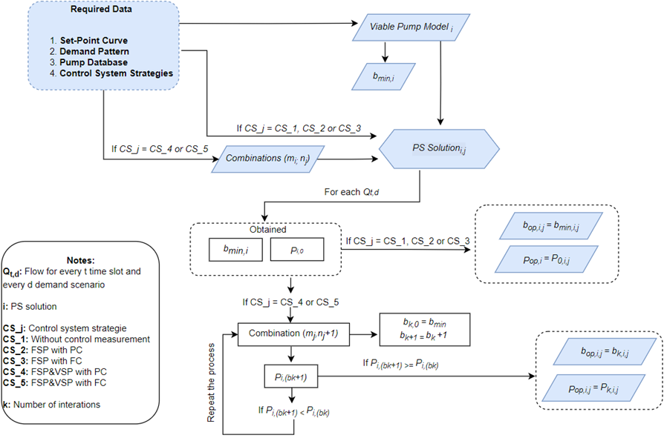
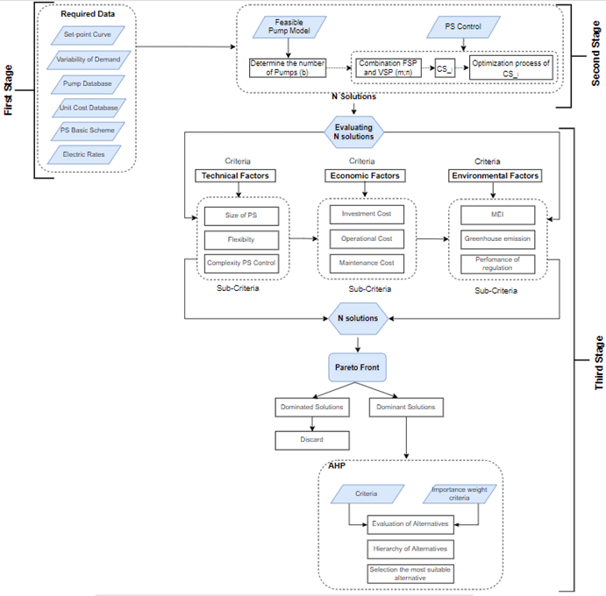
Methodology
Optimization Of The Control System Operation in Pumping Station
Required Data
  Set-Point Curve
  Demand Pattern
  Database of the Pump models
  Electric Tariff
  Costs Database
  Economic Factors
Analysis of variability of Demand
  It is considered 21 different scenarios of non-excedance probability of demand with an Interval of 0.5% from 0% to 100%
Development of the proposed methodology

Slide 5
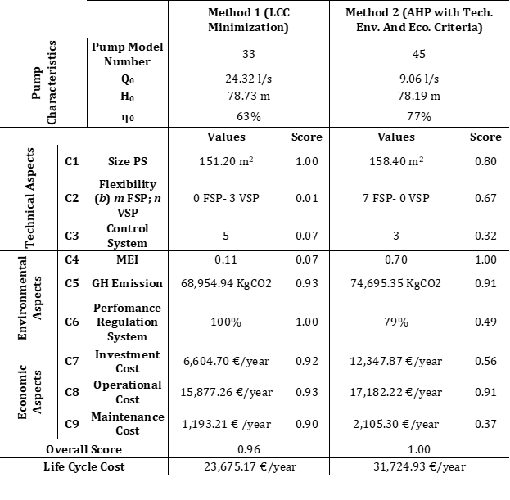
Results
Pumping Station Design based on the minimization of LCC
Pumping Station Design considering Technical, Environmental and Economic Criteria

Slide 6
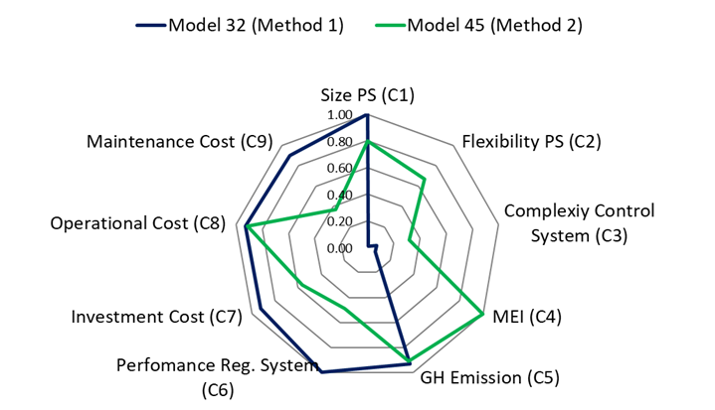
Discussion
The following radial chart shows a comparison of the obtained scores for every sub-criterion of the ultimate solutions of method 1 and method 2. As it can see in this figure, the scores in the sub-criteria of the ultimate solution in Method 2 are over 0.30, whereas the solution in Method 1 has low scores in sub-criteria C2, C3 and C4. Hence, the ultimate solution in Method 2 is more equilibrate with the 9 sub-criteria than the solution in Method 1.

Slide 7
Conclussions
This work developed a methodology for a PS design that consider together technical, environmental, and economic criteria in the design. The process of this methodology is based in the AHP method. This methodology proposed a quantitative assessment of the potential solutions in every one of the criteria. In this way, this work has achieved that the methodology be standardized and could be applied in any kind of PS. In addition, this methodology, has solved the limitations of the classical PS design including technical aspects in the design process.
The principal effect of design a PS with the proposed methodology (Method 2) in contrast to the classical methodology (Method 1) is in the configuration of the PS. The ultimate solution based on Method 2 tends to use a greater number of pumps than in Method 1, but with a smaller flow in the pumps. The control system of the solution in Method 2 is less complex than the solution in Method 1. In summary, the principal effects of Method 2 in contrast with Method 1 are visualized the characteristics in technical aspects because the importance weight of these criteria obtained in the AHP method is high with a weight of 0.41
The inclusion of environmental aspects in a PS design (Method 2) allow that the ultimate solution could have better characteristic in environmental criteria, especially in the MEI, though the importance weight of this criteria is low in comparison with other technical or economic criteria.

Slide 8
THANK YOU FOR YOUR ATTENTION

